Slide 1

Sentiment Analysis of Twitter Data
FR
FABRIKAM RESIDENCES
CIS 5367 Machine Learning
Group Members:
David Kurtenbach
Ayodamloa Olanipekun
Seth Paniagua
Cuong Phan
Folusayo Togun

Slide 2

Project Description
Sentiment Analysis of Twitter Data
Develop and implement a machine learning sentiment analysis model
Analyze Twitter data of large fashion brands
Train/test model
Inform marketing efforts in the fashion industry

Slide 3

Business Case
Targeted Marketing
Local fashion startup company of >75 employees
Sell fast fashion and looking to improve targeted marketing for upcoming quarter
Analysis of 8 large fashion company Twitter feeds to identify trends and inform marketing campaign

Slide 4
Data Description
Sample and Timeframe
Data Details
Fashion Companies
Sample tweets of 8 large fashion companies
Date Range:
2020-11-01 to Present
Sample Size:
Index of 2,400 values
Gucci - #gucci
Polo - #polo
Chanel - #chanel
Burberry - #burberry
Prada - #prada
Versace - #versace
Fendi - #fendi
Hermes - #hermes

Slide 5



Data Source
Accessing Twitter Data
Publicly accessible information
Twitter data imported using an API
Limited to specific twitter handles
Data sourced directly from Excel file

Slide 6
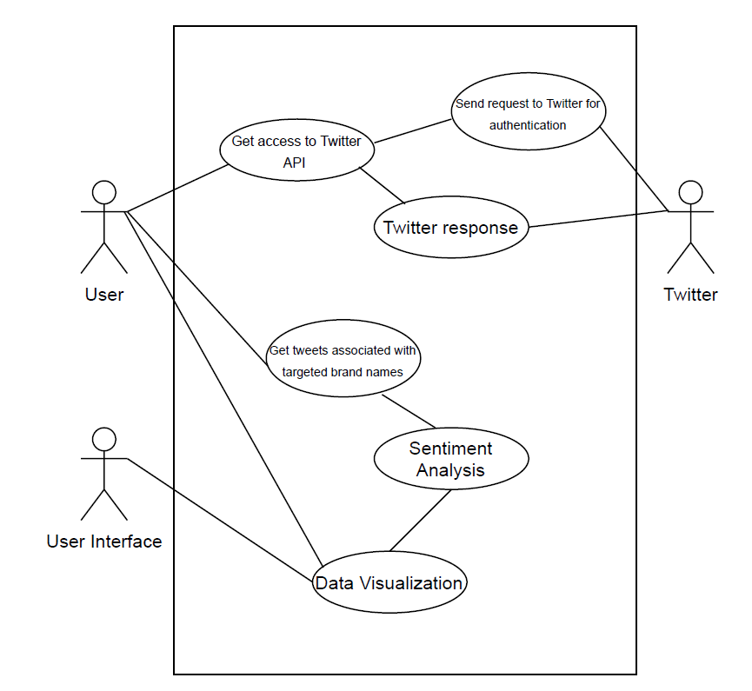
Use Case
User accesses data through Twitter API
Tweets by brand names
Sentiment analysis
Visualize the data

Slide 7
Python Packages
Data Analysis Tools Used
NLTK (Natural Language Tool Kit)
Tweepy
TextBlob
Natural Language Processing (NLP)
Accesses a pattern library to assign values
Assessed Values:
Polarity: Negative vs. Positive (-1.0 => +1.0)
Subjectivity: Objective vs. Subjective (+0.0 => +1.0)
Intensity: Modifies next word? (x0.5 => x2.0)
Identifies words and phrases it can identify, assigns values, and calculates overall score

Slide 8
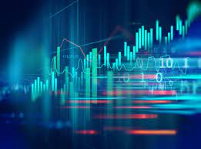
Data Preparation
Cleaning Dataset
Read data into python using API
Standardized the data by removing URLs
Set sample size by Twitter handle
300 samples per handle
Defined sentiment objects
Created TextBlobs for analysis

Slide 9

Data Analysis Process
Apply Spark Dataframe to manipulate and discover data
Preprocess Data
Remove duplicated tweets
Remove missing values
Eliminate uneccesary words such as I,are,is,the,..
Eliminate all icons
Explore Data
Dataset has 1104 tweets
Average word is 94

Slide 10
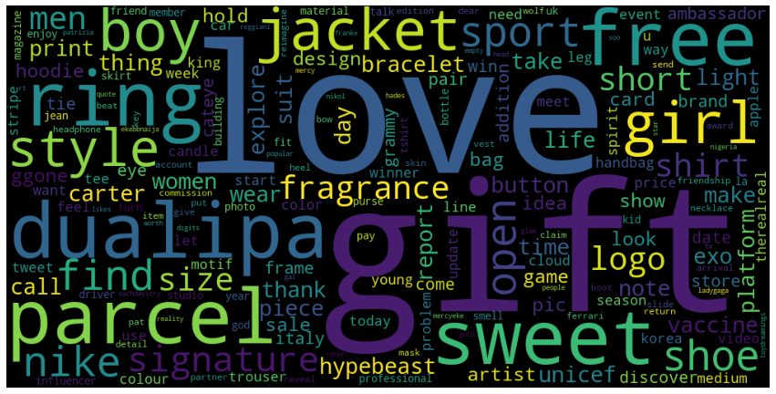
Findings & Results

Slide 11
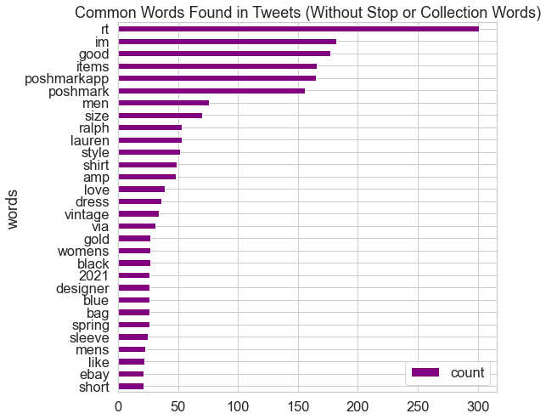
Findings & Results

Slide 12
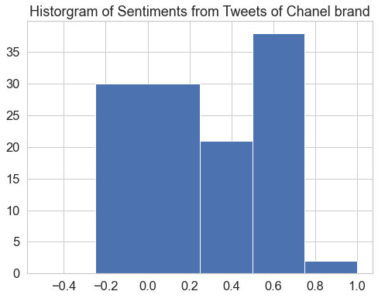
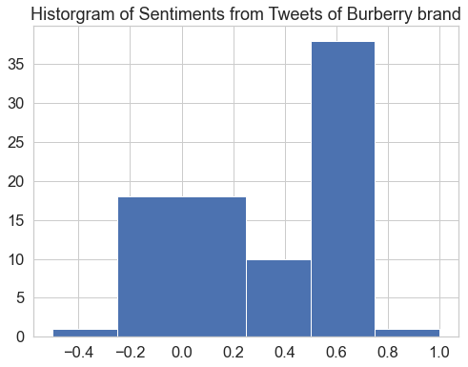
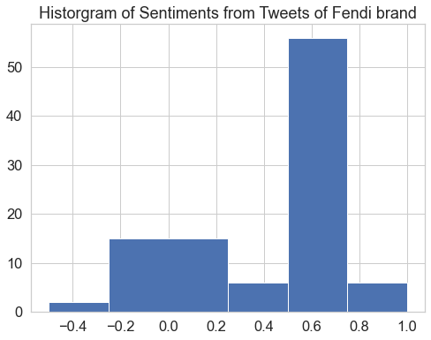
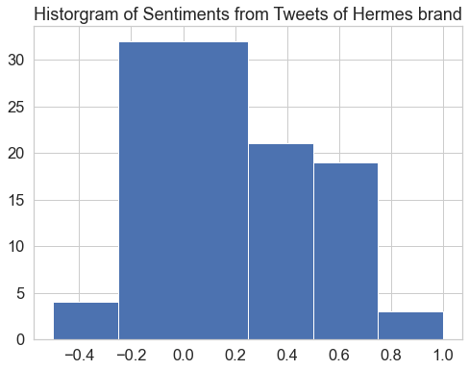
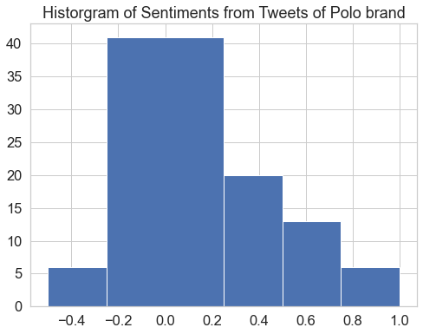
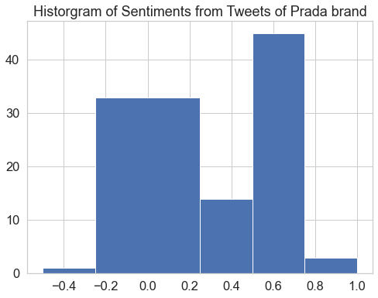
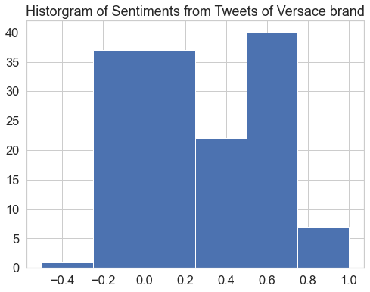
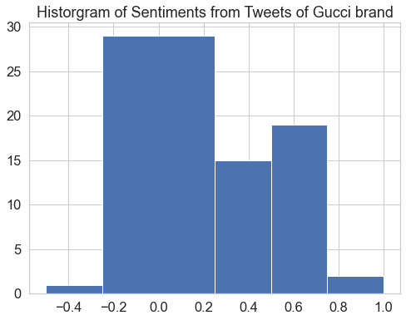
Company Analysis

Slide 13
Data Analysis – Suggesting Model
Using Classification Method to predict the fashion trend
Classification method
-The Naïve Bayes Model: Polarity
Decision Tree: words in Tweet

Slide 14

Business Impacts
Identify fashion trends
Input on what direction large companies are heading
Insight into public opinion
Helps to guide decisions around marketing and product development for our firm

Slide 15
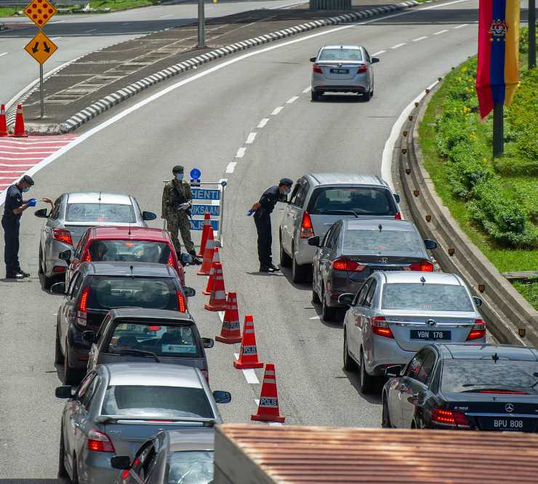
Challenges
Working with new python packages
NLTK concept and application
Twitter API access
Visualizing the data

Slide 16
Thank you

